Slide 1
Chapter 5:
Information
Privacy

Slide 2
Chapter Overview
Introduction
Perspectives on privacy
Information disclosures
Data mining
Examples of consumer backlash
1-<number>

Slide 3
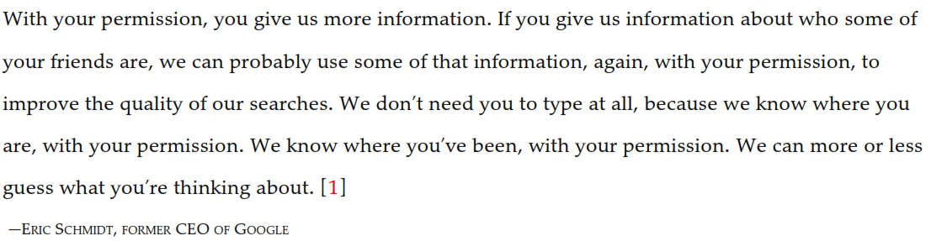
5.1 Introduction
1-<number>

Slide 4
Information Technology Erodes Privacy
Collection, exchange, combination, and distribution of information easier than ever, lessens privacy
Scott McNealy: “You have zero privacy anyway. Get over it.”
We will consider how we leave an “electronic trail” of information behind us and what others can do with this info
1-<number>

Slide 5
5.2 Perspectives on Privacy
1-<number>

Slide 6
Defining Privacy
Privacy related to notion of access
Access
  Physical proximity to a person
  Knowledge about a person
Privacy is a “zone of inaccessibility”
Privacy violations are an affront to human dignity
Too much individual privacy can harm society
Where to draw the line?
1-<number>

Slide 7
Harms of Privacy
Cover for illegal or immoral activities
Burden on the nuclear family
Hidden dysfunctional families
Ignored people on society’s fringes
1-<number>

Slide 8
Benefits of Privacy
Individual growth
Individual responsibility
Freedom to be yourself
Intellectual and spiritual growth
Development of loving, trusting, caring, intimate relationships
1-<number>

Slide 9
Is There a Natural Right to Privacy?
Privacy rights stem from property rights: “a man’s home is his castle”
Coercive Acts before American Revolution led to 3rd Amendment to U.S. Constitution
Samuel Warren and Louis Brandeis: People have “the right to be let alone”
Judith Jarvis Thomson: “Privacy rights” overlap other rights
1-<number>

Slide 10
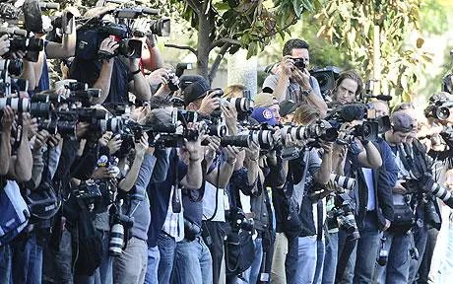
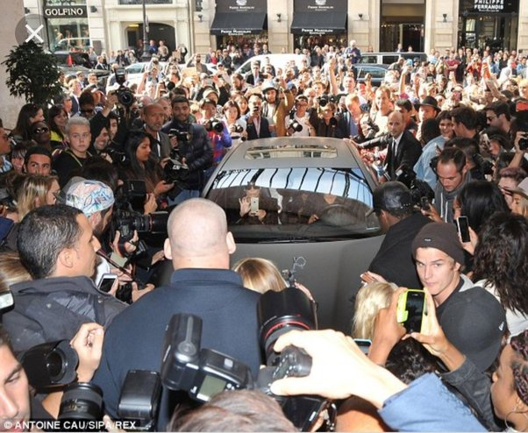
Do People Have the Right to Be Left Alone?
PhamousFotos / Splash News/Newscom
1-<number>

Slide 11
Privacy and Trust
Perhaps modern life is actually more private than life centuries ago
  Most people don’t live with extended families
  Automobile allows us to travel alone
  Television v. public entertainment
Challenge: we now live among strangers
Remedy: establishing reputations
  Ordeal, such as lie detector test or drug test
  Credential, such as driver’s license, key, ID card, college degree
Establishing reputation is done at the cost of reducing privacy
1-<number>

Slide 12
Case Study: New Parents
Sullivans have a baby girl
Both work; they are concerned about performance of full-time nanny
Purchase program that allows monitoring through laptop’s camera placed in family room
They do not inform nanny she is being monitored
1-<number>

Slide 13
Rule Utilitarian Evaluation
If everyone monitored nannies, it would not remain a secret for long
Consequences
  Nannies would be on best behavior in front of camera
  Might reduce child abuse and parents’ peace of mind
  Would also increase stress and reduce job satisfaction of child care providers
  Might result in higher turnover rate and less experienced pool of nannies, who would provide lower-quality care
Harms appear greater than benefits, so we conclude action was wrong
1-<number>

Slide 14
Social Contract Theory Evaluation
It is reasonable for society to give people privacy in their own homes
Nanny has a reasonable expectation that her interactions with baby inside home are private
Sullivan’s decision to secretly monitor the nanny is wrong because it violates her privacy
1-<number>

Slide 15
Kantian Evaluation
Imagine rule, “An employer may secretly monitor the work of an employee who works with vulnerable people”
If universalized, there would be no expectation of privacy by employees, so secret monitoring would be impossible
Proposed rule is self-defeating, so it is wrong for Sullivans to act according to the rule
1-<number>

Slide 16
Virtue Ethics Evaluation
Sullivans are responsible for well-being of their daughter
Chose nanny through concern for baby: characteristic of good parents
Daughter is truly defenseless, unable to communicate with them
Decision to monitor can be viewed as characteristic of good parents
Would also expect them to cease monitoring once assured nanny is doing well
1-<number>

Slide 17
5.3 Information Disclosures
1-<number>

Slide 18
Public Records
Public record: information about an incident or action reported to a government agency for purpose of informing the public
Examples: birth certificates, marriage licenses, motor vehicle records, criminal records, deeds to property
Computerized databases and Internet have made public records much easier to access
1-<number>

Slide 19
Records Held by Private Organizations
Credit card purchases
Purchases made with loyalty cards
Voluntary disclosures
Posts to social network sites
1-<number>

Slide 20
Data Gathering and Privacy Implications
Facebook tags
Enhanced 911 services
Rewards or loyalty programs
Body scanners
RFID tags
Implanted chips
OnStar
Automobile “black boxes”
Medical records
Digital video recorders
Cookies and flash cookies
1-<number>

Slide 21
Facebook Tags
Tag: Label identifying a person in a photo
Facebook allows users to tag people who are on their list of friends
About 100 million tags added per day in Facebook
Facebook uses facial recognition to suggest name of friend appearing in photo
Does this feature increase risk of improper tagging?
1-<number>

Slide 22
Enhanced 911 Services
Cell phone providers in United States required to track locations of active cell phones to within 100 meters
Allows emergency response teams to reach people in distress
What if this information is sold or shared?
1-<number>

Slide 23
Rewards or Loyalty Programs
Shoppers who belong to store’s rewards program can save money on many of their purchases
Computers use information about buying habits to provide personalized service
  ShopRite computerized shopping carts with pop-up ads
Do card users pay less, or do non-users get overcharged?
1-<number>

Slide 24
Body Scanners
Some department stores have 3-D body scanners
Computer can use this information to recommend clothes
Scans can also be used to produce custom-made clothing
1-<number>

Slide 25
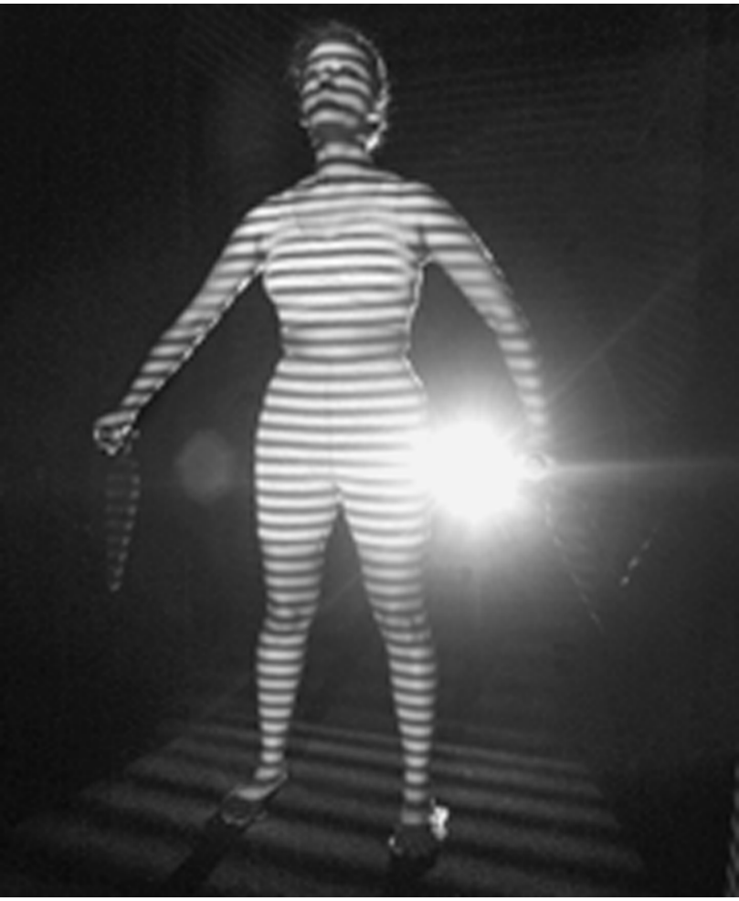
Body Scanner Takes Measurements
AP Photo/Richard Drew
1-<number>

Slide 26
RFID Tags
RFID: Radio frequency identification
An RFID tag is a tiny wireless transmitter
Manufacturers are replacing bar codes with RFID tags
  Contain more information
  Can be scanned more easily
If tag cannot be removed or disabled, it becomes a tracking device
1-<number>

Slide 27
Implanted Chips
Taiwan: Every domesticated dog must have an implanted microchip
  Size of a grain of rice; implanted into ear
  Chip contains name, address of owner
  Allows lost dogs to be returned to owners
RFID tags approved for use in humans
  Can be used to store medical information
  Can be used as a “debit card”
1-<number>

Slide 28
OnStar
OnStar manufactures communication system incorporated into rear-view mirror
Emergency, security, navigation, and diagnostics services provided subscribers
Two-way communication and GPS
Automatic communication when airbags deploy
Service center can even disable gas pedal
1-<number>

Slide 29
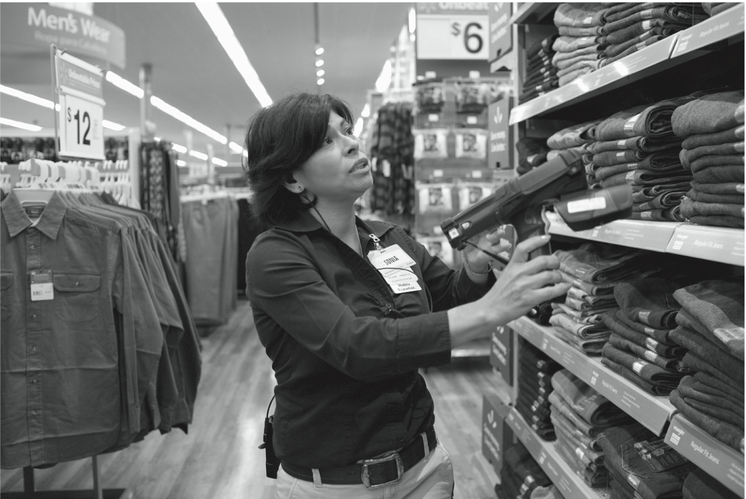
RFID Tags Speed Inventory Process
© Marc F. Henning / Alamy
1-<number>

Slide 30
Automobile “Black Boxes”
Modern automobiles come equipped with a “black box”
Maintains data for five seconds:
  Speed of car
  Amount of pressure being put on brake pedal
  Seat belt status
After an accident, investigators can retrieve and gather information from “black box”
1-<number>

Slide 31
Medical Records
Advantages of changing from paper-based to electronic medical records
Quicker and cheaper for information to be shared among caregivers
  Lower medical costs
  Improve quality of medical care
Once information in a database, more difficult to control how it is disseminated
1-<number>

Slide 32
Digital Video Recorders
TiVo service allows subscribers to record programs and watch them later
TiVo collects detailed information about viewing habits of its subscribers
Data collected second by second, making it valuable to advertisers and others interested in knowing viewing habits
1-<number>

Slide 33
Cookies
Cookie: File placed on computer’s hard drive by a Web server
Contains information about visits to a Web site
Allows Web sites to provide personalized services
Put on hard drive without user’s permission
You can set Web browser to alert you to new cookies or to block cookies entirely
1-<number>

Slide 34
Flash Cookies
Flash cookie: File placed on your computer’s hard drive by a Web server running the Adobe Flash Player
Flash cookie can hold 25 times as much information as a browser cookie
Flash cookies not controlled by browser’s privacy controls
Some Web sites use flash cookies as a way of backing up browser cookies. If you delete browser cookie, it can be “respawned” from the flash cookie
Half of 100 most popular Web sites use flash cookies
1-<number>

Slide 35
5.4 Data Mining
1-<number>

Slide 36
Data Mining Defined
Searching records in one or more databases, looking for patterns or relationships
Can be used to create profiles of individuals
Allows companies to build more personal relationships with customers
1-<number>

Slide 37
Google’s Personalized Search
Secondary use: Information collected for one purpose use for another purpose
Google keeps track of your search queries and Web pages you have visited
  It uses this information to infer your interests and determine which pages to return
  Example: “bass” could refer to fishing or music
Also used by retailers for direct marketing
1-<number>

Slide 38
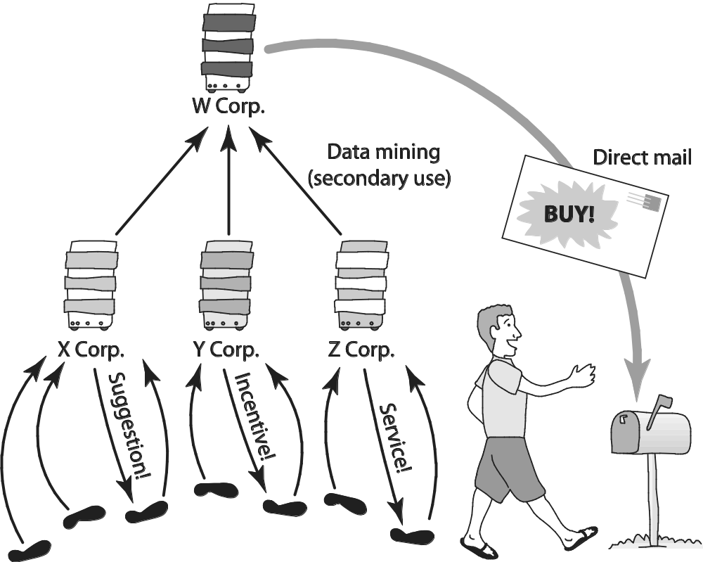
Secondary Uses of Information
1-<number>

Slide 39
Collaborative Filtering
Form of data mining
Analyze information about preferences of large number of people to predict what one person may prefer
  Explicit method: people rank preferences
  Implicit method: keep track of purchases
Used by online retailers and movie sites
1-<number>

Slide 40
Ownership of Transaction Information
Who controls transaction information?
  Buyer?
  Seller?
  Both?
Opt-in: Consumer must explicitly give permission before the organization can share info
Opt-out: Organization can share info until consumer explicitly forbid it
Opt-in is a barrier for new businesses, so direct marketing organizations prefer opt-out
1-<number>

Slide 41
Credit Reports
Example of how information about customers can itself become a commodity
Credit bureaus
  Keep track of an individual’s assets, debts, and history of paying bills and repaying loans
  Sell credit reports to banks, credit card companies, and other potential lenders
System gives you more choices in where to borrow money
Poor credit can hurt employment prospects
1-<number>

Slide 42
Targeted Direct Mail
Businesses mail advertisements only to those most likely to purchase products
Experian and other companies provide customized mailing lists
Example: Target’s efforts to reach pregnant women
1-<number>

Slide 43
Microtargeting
Political campaigns determine voters most likely to support particular candidates
  Voter registration
  Voting frequency
  Consumer data
  GIS data
Target direct mailings, emails, text messages, home visits to most likely supporters
1-<number>

Slide 44
Price Customization
Data aggregation firms sell profiles of shopper to on-line retailers
Retailers use this information to offer different prices to different people
1-<number>

Slide 45
Social Network Analysis
Collect information from social networks to inform decisions
Bharti Airtel (India) offers special promotions to “influencers”
Police use Facebook and Twitter posts to deploy officers on big party nights
Banks combine social network data with credit reports to determine creditworthiness
1-<number>

Slide 46
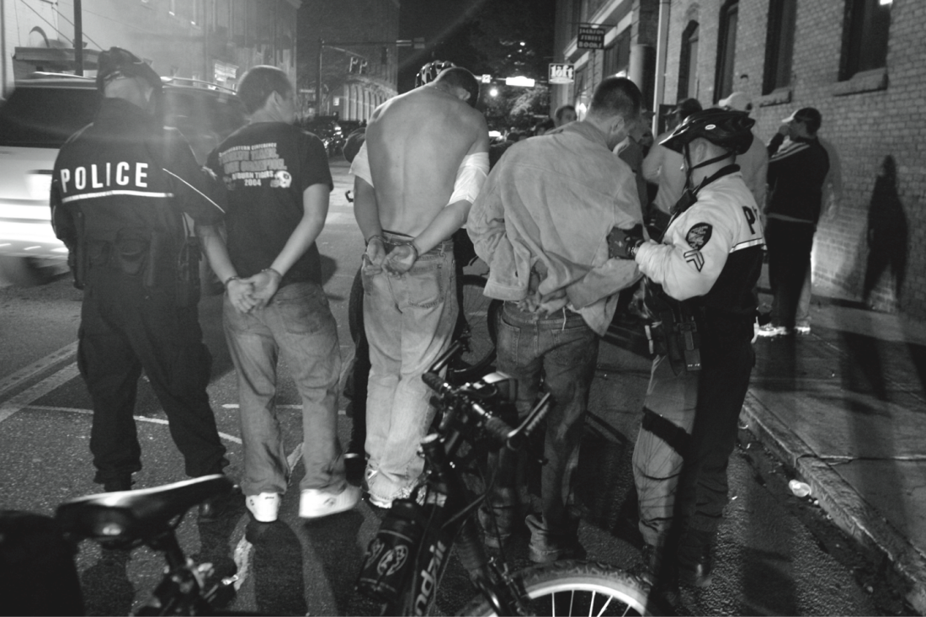
Police Monitor Facebook and Twitter to Identify Locations of Big Parties
© Allen Sullivan/ZUMA Press/Newscom
1-<number>

Slide 47
5.5 Examples of Consumer Backlash
1-<number>

Slide 48
Marketplace: Households
Lotus Development Corporation developed CD with information on 120 million Americans
Planned to sell CD to small businesses that wanted to create mailing lists based on various criteria, such as household income
More than 30,000 consumers complained to Lotus about invasion of privacy
Lotus dropped plans to sell CD
1-<number>

Slide 49
Facebook Beacon
Fandango, eBay, and 42 other online businesses paid Facebook to do “word of mouth” advertising
Facebook users surprised to learn information about their purchases was shared with friends
Beacon was based on an opt-out policy
Beacon strongly criticized by various groups
Facebook switched to an opt-in policy regarding Beacon
1-<number>

Slide 50
Netflix Prize
Netflix offered $1 million prize to any group that could come up with a significantly better algorithm for predicting user ratings
Released more than 100 million movie ratings from a half million customers
  Stripped ratings of private information
Researchers demonstrated that ratings not truly anonymous if a little more information from individuals was available
U.S. Federal Trade Commission complaint and lawsuit
Netflix canceled sequel to Netflix Prize
1-<number>

Slide 51
Malls Track Shoppers’ Cell Phones
In 2011 two malls recorded movement of shopper by tracking locations of cell phones
  How much time people spend in each store?
  Do people who shop at X also shop at Y?
  Are there unpopular areas of mall?
Small signs informed shoppers of study
After protest, mall quickly halted study
1-<number>

Slide 52
iPhone Apps Upload Address Books
In 2012 a programmer discovered Path was uploading iPhone address books without permission
Internet community pointed out this practice violated Apple’s guidelines
CEO of Path apologized; app rewritten
Twitter, Foursquare, and Instagram also implicated for same practice
1-<number>

Slide 53
Instagram’s Proposed Change to Terms of Service
Late 2012: Instagram announced changes
  Privacy policy
  Terms of service
Legal experts: Instagram and Facebook would have right to use photos in ads without permission
Instagram CEO: New policy misunderstood
Changed advertising section of terms of service agreement back to original version
1-<number>

